Slide 1
Year 11 Information Evening 28th March 2023

Slide 2
Steps to Success at GCSE
School
Home
Pupil
A Local School with global vision.

Slide 3
Feedback on Year 11 so far this year…
Positives
Learners’ punctuality to examinations was much improved.
Learners showed they knew exactly how to adhere to the JCQ regulations.
Learners are continuing to attend revision sessions and be proactive in making sure they have all the resources they need.
Learners who had engaged with the support offered by teachers in Science (Combined, Chemistry and Biology) and MFL made noticeable progress from mocks 1 to mocks 2.
Excellent attitudes to success shown in Drama and Food examinations – and in today’s day one of the Art examination.
Learning Points
Some learners were late in the mornings or missed examinations due to absence.
Learners need to listen carefully to the feedback from their teachers to made sure they are focusing their revision and exam practice on the right areas.
Learners need to be doing lots and lots of practice questions and getting feedback on these.
A Local School with global vision.

Slide 4
What we are doing to support: Ongoing
For everyone:
Subject Specific Tutor Groups
Revision sessions before and after school
Revision resources (knowledge organisers, revision guides, flash cards)
Regrouping in Maths, English and Science for after Easter for an intensive and targeted 4 weeks in the run up to the exams
Adapted timetable from 15th May for all Year 11 learners so their lessons directly match to their next examination as far as possible
By invitation:
MyTutor
A Local School with global vision.

Slide 5
What we are doing to support: GCSE Pod
GCSEPod is proven to help students achieve one grade higher on average than non-users, across 30+ GCSE subjects and all exam boards.
You can find out more information here: Parent Resources - GCSEPod
Watch out for access codes and information coming out to Year 11 learners this week!
A Local School with global vision.

Slide 6
What we are doing to support: Revision School
 | Monday 3/4 | Tuesday 4/4 | Wednesday 5/4 | Thursday 6/4
AM 10:00-12:00 | History – year 11 – MWZ (Medicine) Chemistry – Year 13 – LWN Music – year 10 – LTD BTEC Sport Year 10 & 11 – CWR/JCD Maths – Year 11 | Computer Science – Year 13 – STN Chemistry – Year 11 – LWN English– Yr 11 –GTH (Lang Paper 1) Health and Social Care 10,11,13– DHN BTEC Sport Year 10 & 11 – JCD Media – Year 13 – MEW Maths – Year 11 | Physics – Year 11 - JES Computer Science – Year 11 – STN History – year 13 -DNE English – Yr11 – GTH (AIC) Psychology – Year 11 – MNN Health and Social Care Years 10,11,13– JWN Geography - Year 11 – PMN Media – Year 11 - MEW | Health and Social Care 10,11,13– CWE & DHN Physics - Year 11 – Separate Science only Maths – Year 11
Lunch
PM 12:30-14:30 | History – year 11 – MWZ (American West) Chemistry -Year 13 –LWN BTEC Sport Year 10 & 11– CWR/JCD Maths – Year 11 | Computer Science – Year 13 – STN Chemistry – Year 11 – LWN English – Yr11 – GTH (Lang Paper2) BTEC Sport Year 10 & 11 – JCD Media – Year 13 – MEW Maths – Year 11 | Physics – Year 11 - JES Computer Science – Year 11 – STN History –year 13 -DPN Psychology – Year 13 – MNN Health and social Care Years 10,11,13- JWN Geography – Year 11 – PMN | Health and Social Care 10,11,13- CWE Physics - Year 11 – Separate Science only Maths – Year 11
A Local School with global vision.

Slide 7
Examinations Information
Candidate Examination Handbook
Information about procedures for examinations
JCQ regulations about examinations
What to bring/what not to bring to examinations
What to do if running late or are absent from an examination
What to do in the event of an emergency (eg fire alarm) during an examination
Information for candidates with access arrangements
Results day arrangements
Post-results services including how to request a review of marking
Certificates
Complaints and appeals procedures
A Local School with global vision.

Slide 8
Updates from the Exam Boards
Contingency Planning
In case of a local or national disruption to examinations in the UK, the exam boards may move an examination in the summer to one of the following contingency dates:
the afternoon of Thursday 8 June 2023
the afternoon of Thursday 15 June 2023
the morning of Wednesday 28 June 2023
the afternoon of Wednesday 28 June 2023
A Local School with global vision.

Slide 9
Updates from the Exam Boards
Contingency Planning
In the unlikely event the school is instructed not to run a national examination, we will provide the exam board with the learners’ mock grades from the mocks they sat in February 2023.
Therefore, we have to run these exams exactly how they will be run in the summer and follow all JCQ requirements exactly.
A Local School with global vision.

Slide 10
Exam Rules
JCQ is the Joint Council for Qualifications.
They set the rules and regulations for all exams and qualifications in the UK.
If these rules are not followed, candidates are disqualified from the exam and, in some cases, the qualification. In some instances, all candidates sitting the exam are disqualified if the exam board feel the integrity of the exam has been compromised.
A Local School with global vision.

Slide 11
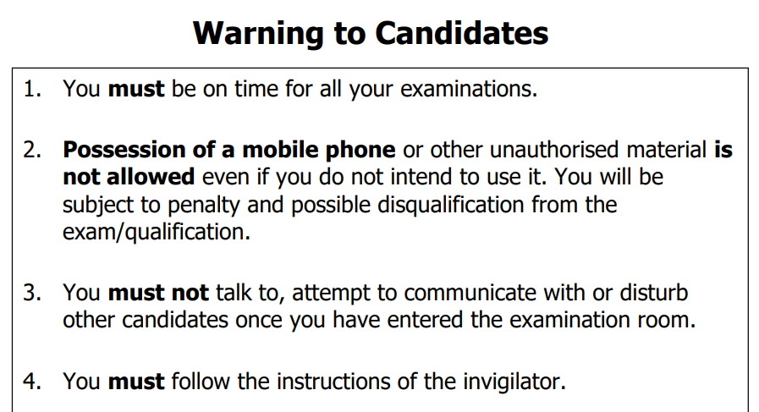
Exam Rules
A Local School with global vision.

Slide 12
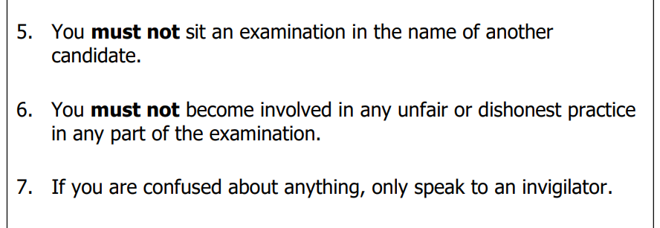
Exam Rules
A Local School with global vision.

Slide 13
Exam Rules
A Local School with global vision.

Slide 14
Exam Rules Update
Drinks:
still water in a clear, unlabelled bottle
Food:
only if medically required and pre-approved by the Medical Officer and Exams Team – must be in a clear plastic sandwich bag with no wrapping or label
Use of the toilet during exams:
Candidates should use the toilets prior to entering the examination hall
Those with medical conditions requiring access to toilets will be seated in an appropriate location and invigilators will be aware of their needs
For all other candidates, they will not be allowed to leave the examination during the first hour or the last half an hour of any examination
A Local School with global vision.

Slide 15
Exams Briefing
A Local School with global vision.

Slide 16
Steps to Success at GCSE
School
Home
Pupil
A Local School with global vision.

